Slide 1
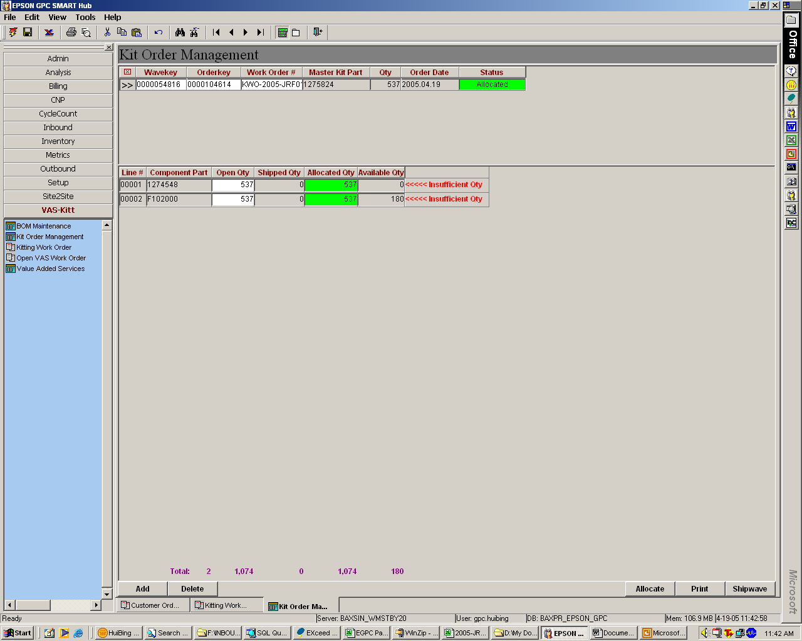
Plse check. Remarks reflected although there are sufficient quantity
Allow selection for allocation:
1) LP, Lot and Location

Slide 2
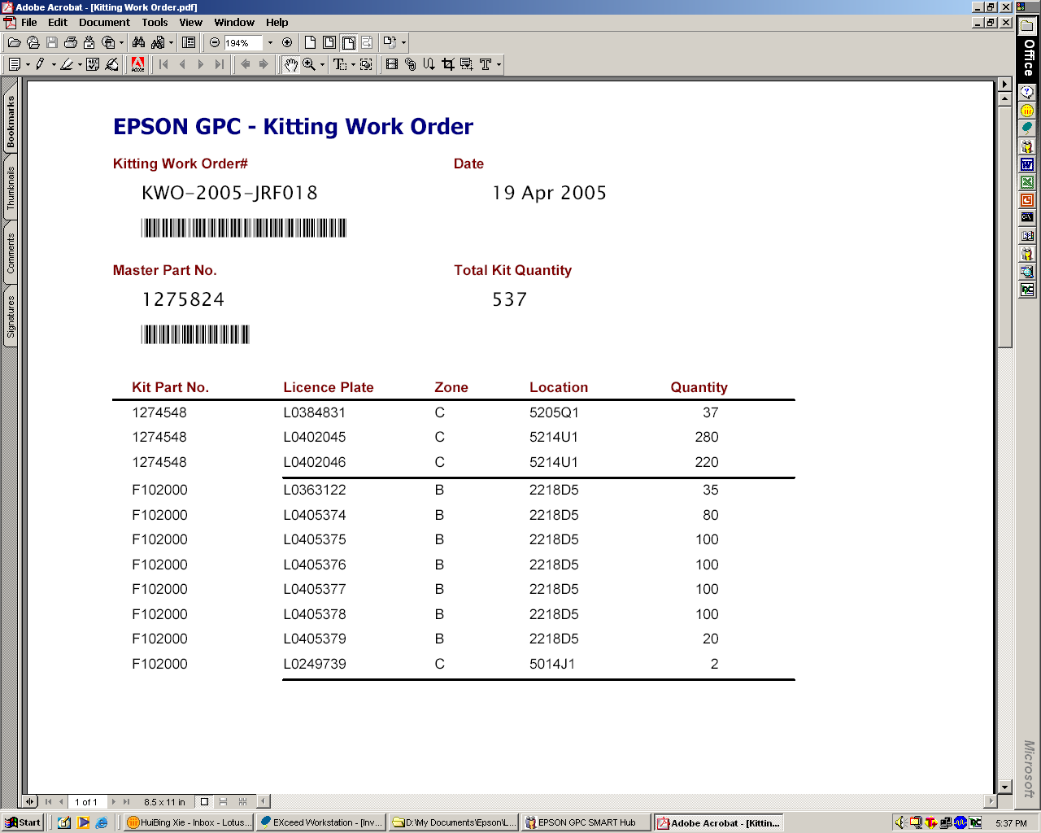
Indicate the packaging consumables P/N and available quantity
Similar information is reflected in the existing Repack Work Order. Plse use the same format.

